Slide 1


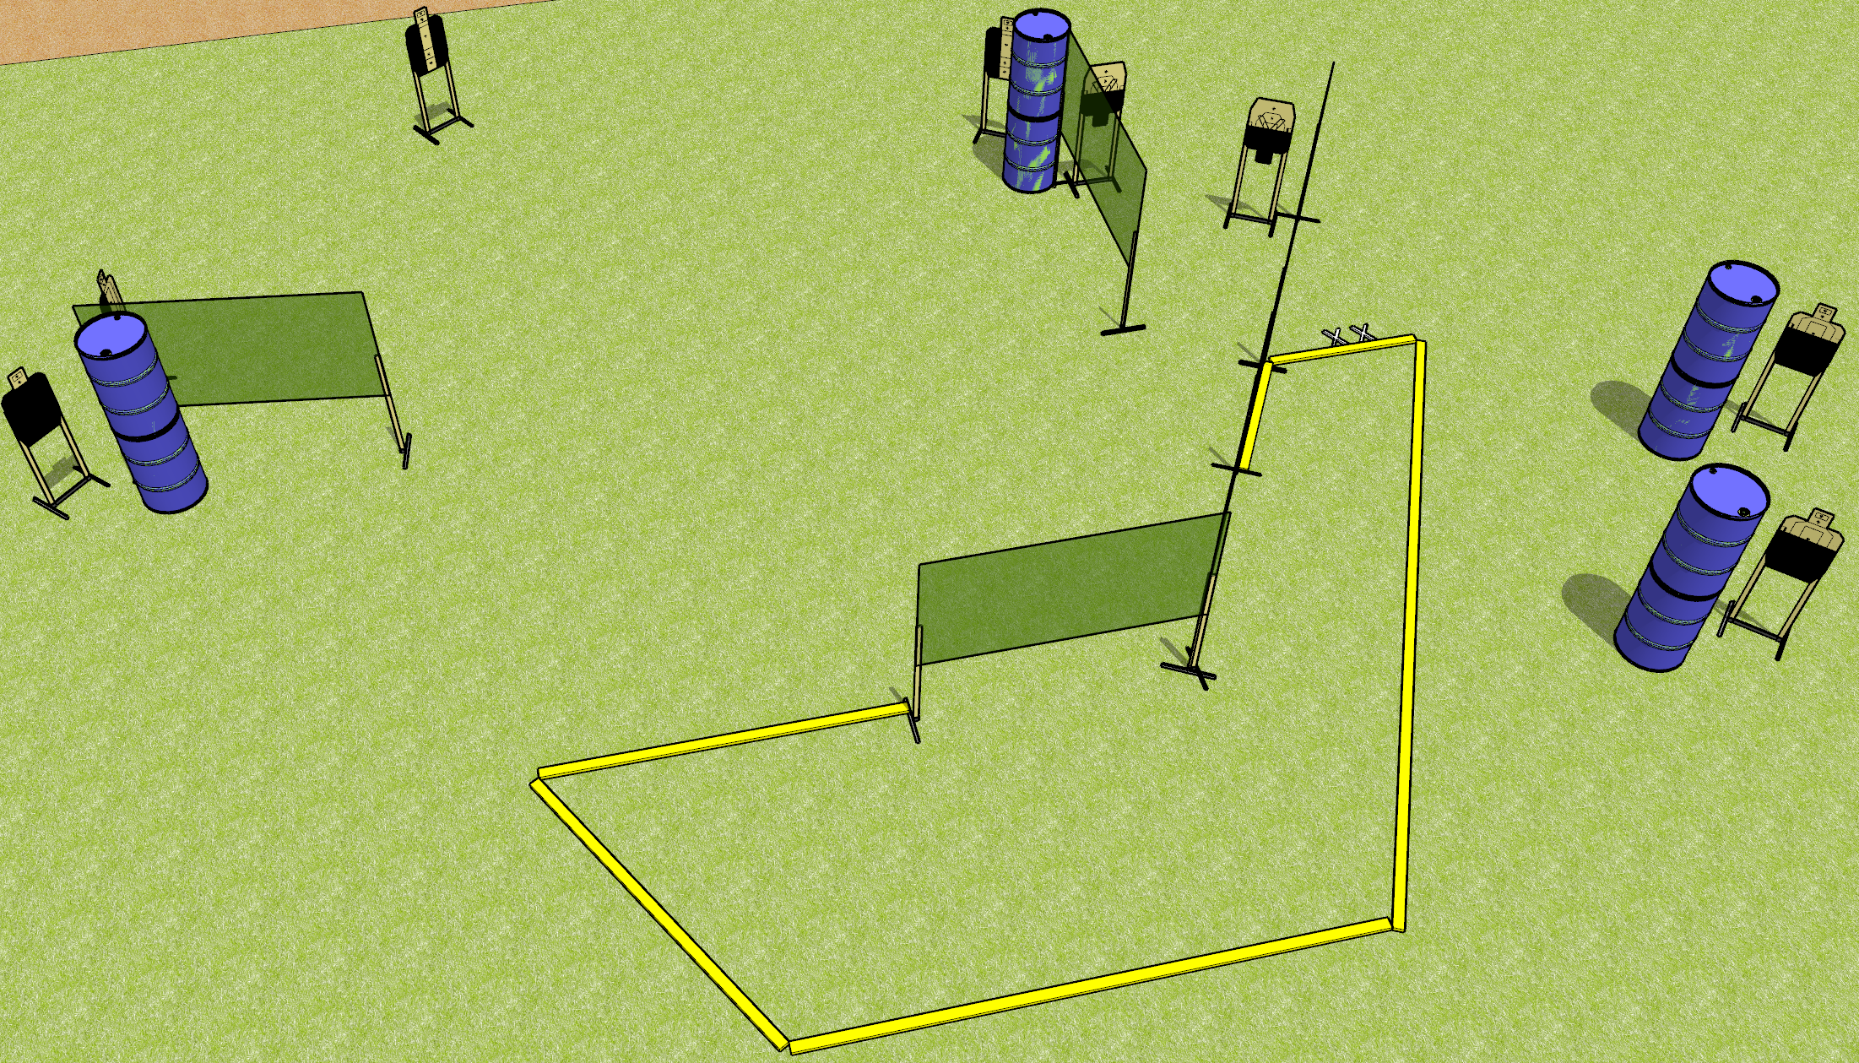
 | Dothan Gun Club – USPSA Match Partials Everywhere! Course Designer : Drew Coleman
START POSITION : Standing with both feet on X’s, heels against (not on) fault line, wrists below belt
GUN READY CONDITION : Pistol loaded and holstered. PCC loaded, shouldered, safety on, pointed at orange cone. |  | SCORING: Comstock, 16 rounds TARGETS: 8 paper, 0 Steel SCORED HITS: Best 2 on paper, steel until down START-STOP: Audible, last shot RULES:
STAGE PROCEDURE: Engage targets as they become available from within the fault lines.

Slide 2
Partials Everywhere!
Written Stage Briefing
Partials Everywhere! is a 16 round, 80 point, Comstock medium course. There are eight USPSA targets. The best two hits on paper will score. The start signal is audible.
Handgun start position is standing with both feet on X’s, heels against but not on top of the fault line. Handgun is loaded and holstered.
PCC start position is standing with both feet on X’s, heels against but not on top of the fault line. Loaded carbine held with both hands, shouldered, safety on, pointed at orange cone.
On start signal, engage targets as they become available from within the shooting area.

